Slide 1


Slide 2
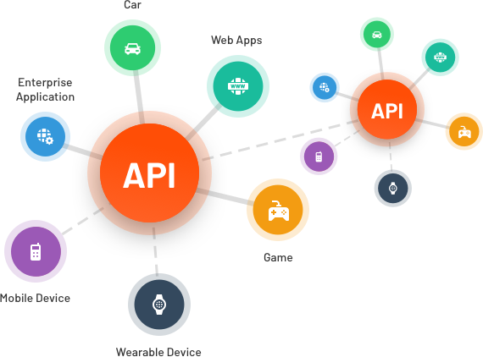

REST API basics
Wendafrash Buzuayehu
Senior Specialist Enterprise Integration

Slide 3
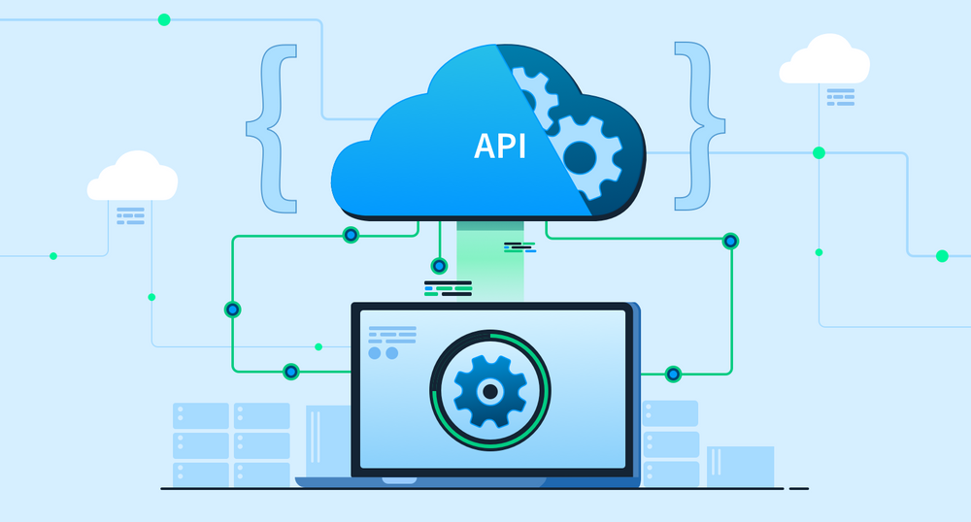
Introduction to REST API
The primary objectives of today's presentation are :
To equip you with a comprehensive understanding of REST APIs.
To emphasize the significant role REST APIs play in the contemporary landscape of software development.
APIs are the building blocks of modern digital ecosystems, and REST in particular, is a fundamental architectural style that governs how these APIs work.
To begin, let's explore the basic concepts and principles that underpin REST APIs.

Slide 4
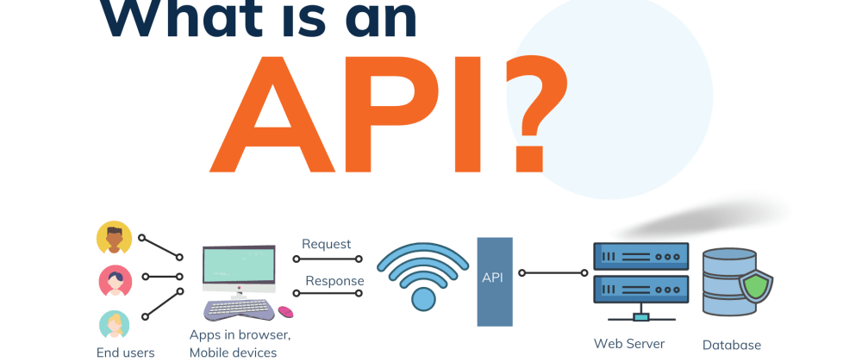
What is API
Definition of API: An API, or Application Programming Interface, is a set of rules and protocols that allows one software application to interact with another. It serves as a bridge that enables different software systems to communicate and share data.

Slide 5
Understanding APIs in Software Development
Role in Software Development: APIs play a crucial role in software development and integration for the following reasons:
Interoperability: APIs facilitate seamless communication between different software components, whether they are running on the same system or on different devices and platforms.
Reuse of Code: APIs allow developers to reuse existing code and functionality in new applications, saving time and effort.
Modularity: They enable software to be built in a modular fashion, where each component has a well-defined interface (API) that can be developed and tested independently.
Third-party Integration: APIs enable third-party developers and services to integrate with existing software, expanding functionality and capabilities.
Scalability: Through APIs, applications can easily scale and adapt to changing requirements by adding or modifying components.
Ecosystem Growth: APIs foster the creation of ecosystems where developers, partners, and users can collaborate and build on top of a platform.

Slide 6
Understanding REST Architecture
Definition of REST: REST (Representational State Transfer) is an architectural style for designing networked applications. It is based on a set of constraints and principles that emphasize a stateless client-server relationship and the use of standard HTTP methods.
Principles of REST: REST is guided by several key principles, including statelessness, client-server separation, a uniform interface, and the use of resources and representations.
Why REST is Popular: REST has gained popularity due to its simplicity, scalability, and wide adoption of HTTP, making it the basis for most web services and APIs.

Slide 7
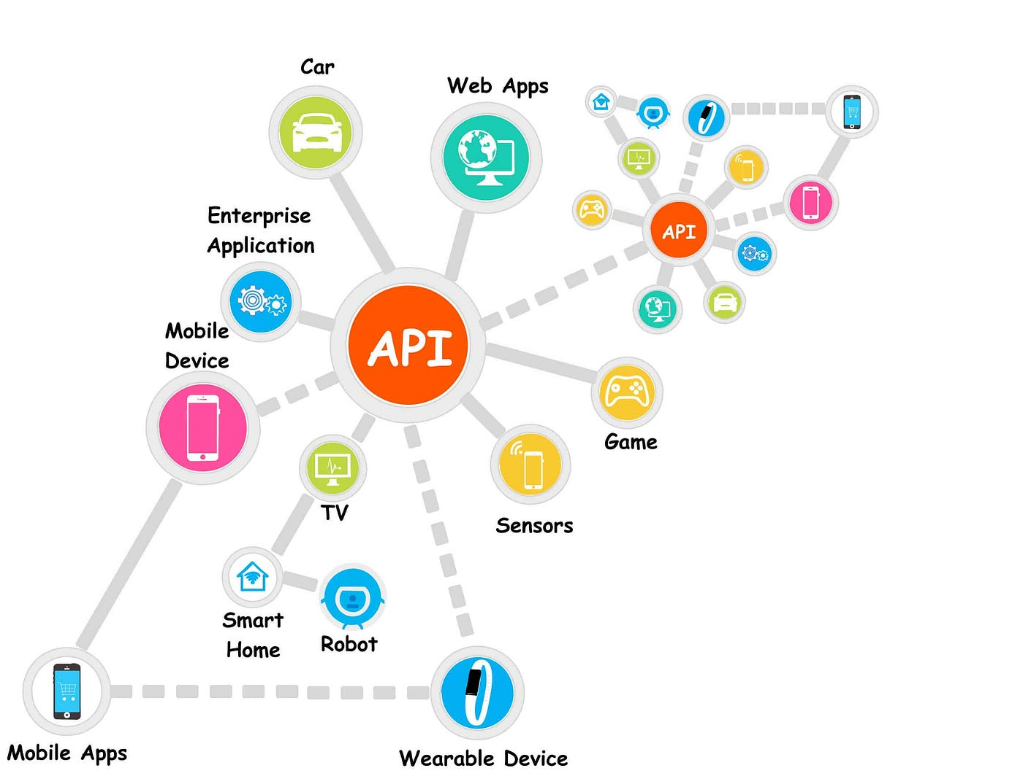
Exploring REST Architecture
Definition of REST: REST (Representational State Transfer) is an architectural style for networked applications.
Principles of REST: REST follows principles like statelessness, client-server separation, a uniform interface, and resource-based interactions.
Why REST is Popular: REST's simplicity, scalability, and alignment with HTTP have contributed to its popularity.

Slide 8
Key REST API Concepts
Resources: Resources are objects or data entities identified by URIs.
URIs: URIs uniquely identify resources; they often take the form of URLs.
HTTP Methods: HTTP methods (e.g., GET, POST, PUT, DELETE) are used for actions on resources.
Statelessness: REST is stateless, meaning each request contains all necessary information, and the server doesn't store client state.

Slide 9
Resources and URIs
Resources: These are the core building blocks of REST APIs. They represent objects or data entities.
URIs: Uniform Resource Identifiers (URIs) are like addresses for resources. They uniquely identify them and often look like URLs (Uniform Resource Locators).

Slide 10
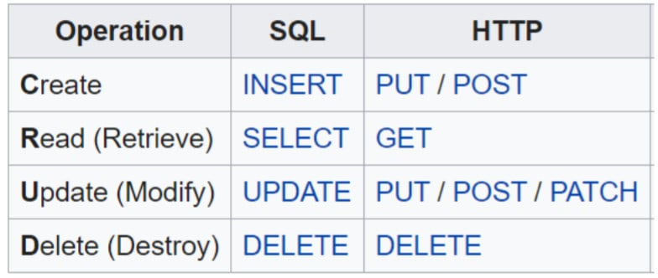
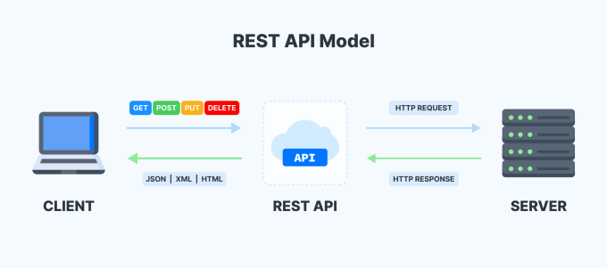
HTTP Methods in REST
HTTP Methods: In REST, standard HTTP methods are used to interact with resources. Here are the primary ones:
GET: Used for retrieving data.
POST: Used for creating new resources.
PUT: Used for updating existing resources.
DELETE: Used for removing resources.

Slide 11
Requests and Responses in REST
Structure: REST requests and responses have a structured format.
Components: Both include headers, body, and status codes.

Slide 12
HTTP Status Codes in REST
Status Codes: HTTP status codes are three-digit numbers indicating the result of an HTTP request.
Examples:
200 OK: Successful request.
201 Created: Resource successfully created.
404 Not Found: Resource not found.
500 Internal Server Error: Server encountered an error.

Slide 13
Characteristics of RESTful APIs
RESTful APIs: Characteristics that define a RESTful API include:
Statelessness
Client-Server Separation
Uniform Interface
Resource-Based

Slide 14

Comparing REST and SOAP
Comparison: REST and SOAP are two different approaches to building web services.
Differences:
REST: Lightweight, stateless, and uses standard HTTP methods.
SOAP: Protocol-based, XML-heavy, and stateful.

Slide 15
Real-World Applications of REST APIs
Examples: Explore real-world applications of RESTful APIs.
Social Media Platforms (e.g., Twitter, Facebook): API usage for data retrieval and integration.
E-commerce Sites: Integrating with payment gateways, inventory management.
Public APIs (e.g., Google Maps): Accessing services and data from external providers

Slide 16
